Slide 1
Multiplexer
Reference: Chapter 3
Moris Mano 4th Edition

Slide 2
Multiplexer (MUX/Data Selector)
Used for Selection
Takes 2^{n} information inputs
Sends only one input to output line always
Based on n selection input
I0
m - to - 1
MUX
(m = 2^{n})
I1
.
.
Y
Im-1
S0
…
Sn-1

Slide 3
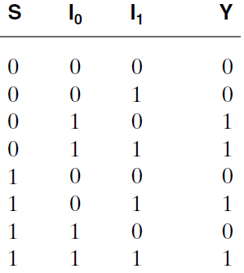
2-to-1 Multiplexer
I0
2×1
MUX
I1
Y
S
S | Y
0 | I0
1 | I1
Truth table for 2x1 MUX
Condensed Truth Table

Slide 4
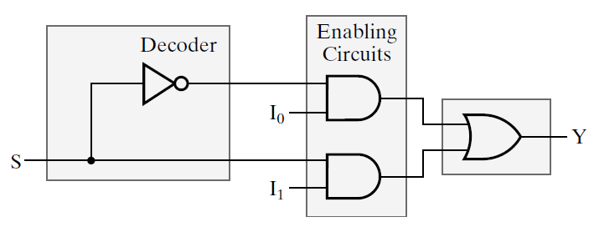
2-to-1 Multiplexer
D0
D1

Slide 5
2-to-1 Multiplexer
Dj . Ij
If Ij = 0 → 0 Passed forward
If Ij = 1 → Ij Passed forward
X.1 = X
D0 = 1
I0
= I0
0
D1 = 0
0
X.0 = 0

Slide 6
2-to-1 Multiplexer
D0 = 0
0
= I1
1
D1 = 1
I1

Slide 7
2-to-1 Multiplexer
Derive Equation from Circuit:
Y = S’I0 + SI1
S’
S’I0
S
S’I0 + SI1
SI1

Slide 8
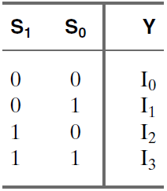
4-to-1 Multiplexer
I0
I1
4×1
MUX
Y
I2
I3
S1
S0
Condensed Truth Table
MUX Block
4 = 2²
2 Selection Inputs

Slide 9
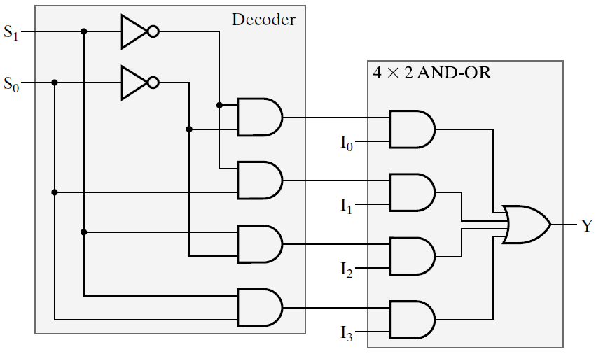
4-to-1 Multiplexer
nx2^n Decoder
Condensed Truth Table

Slide 10
4-to-1 Multiplexer
nx2^n Decoder
1
0
Condensed Truth Table

Slide 11
4-to-1 Multiplexer
nx2^n Decoder
1
0
0
0
Condensed Truth Table
1
0

Slide 12
4-to-1 Multiplexer
nx2^n Decoder
1
0
0
0
0
Condensed Truth Table
0
1
I2
0
0

Slide 13
4-to-1 Multiplexer
nx2^n Decoder
1
0
0
0
0
Condensed Truth Table
0
1
I2
I2
0
0

Slide 14
4-to-1 Multiplexer
nx2^n Decoder
0
0
Condensed Truth Table

Slide 15
4-to-1 Multiplexer
nx2^n Decoder
0
1
0
0
Condensed Truth Table
0
0

Slide 16
4-to-1 Multiplexer
nx2^n Decoder
0
1
0
I0
0
Condensed Truth Table
0
0
0
0
0

Slide 17
4-to-1 Multiplexer
nx2^n Decoder
0
1
0
I0
0
Condensed Truth Table
0
0
I0
0
0
0

Slide 18
4-to-1 Multiplexer
Write Equation for this MUX (output Y)
Condensed Truth Table

Slide 19
4-to-1 Multiplexer
Condensed Truth Table

Slide 20
4-to-1 Multiplexer
Y = m0I0 + m1I1 + m2I2 + m3I3
Condensed Truth Table

Slide 21
Multiplexer Functionality
Forward Information Ix to output Line Y where (x)10 = (Sn-1Sn-2…S1S0)2

Slide 22
8x1 MUX
Equation and Circuit
Do yourself

Slide 23
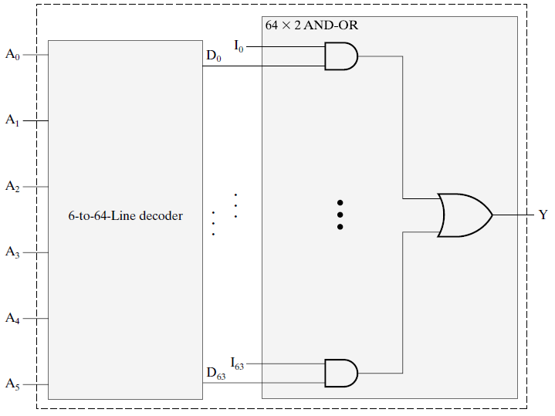
64-to-1 Multiplexer
2^6 = 64

Slide 24
2-to-1 Quadruple Multiplexer
Quadruple → Information size = 4-bits
Takes two 4-bit numbers e.g.
A = 1011
B = 1101
Sends one of the numbers to output (Total 4 output lines, 1 line per bit)
No of selection doesn’t not depends on bits it stills depends on no of ips. By ALI
S | Y
0 | Select A
1 | Select B
2x1
Quad
MUX
A
Y
B
S

Slide 25
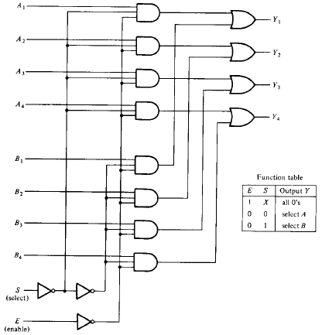
2-to-1 Quadruple Multiplexer
2x1
Quad
MUX
A
Y
B
S

Slide 26
2-to-1 Quadruple Multiplexer
2x1
Quad
MUX
A
Y
B
S
E = 0
1

Slide 27
2-to-1 Quadruple Multiplexer
S = 1
S = 1
2x1
Quad
MUX
A
S = 1
Y
B
S = 1
S = 0
S
S = 0
S = 0
S = 0
E = 0
1

Slide 28
2-to-1 Quadruple Multiplexer
A1
S = 1
A2
S = 1
2x1
Quad
MUX
A
A3
S = 1
Y
A4
B
S = 1
S = 0
0
0
S
S = 0
S = 0
0
0
S = 0
E = 0
1

Slide 29
2-to-1 Quadruple Multiplexer
A1
S = 1
0
Yi = Ai
A2
S = 1
2x1
Quad
MUX
0
A
A3
S = 1
0
Y
A4
B
S = 1
0
S = 0
0
0
S
S = 0
S = 0
0
0
S = 0
E = 0
1

Slide 30
4-to-1 Quad Multiplexer
4x1
Quad
MUX
A
B
Y
C
D
S1
S0

Slide 31
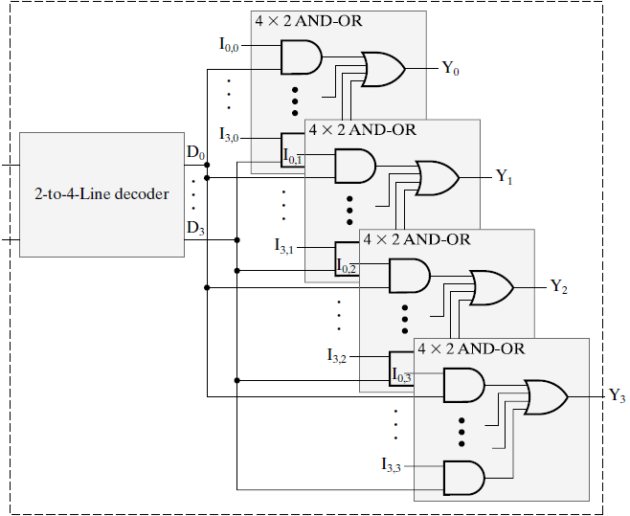
4-to-1 Quad Multiplexer
S0
S1
Total Information
= 4 (e.g. 4 Numbers)
Size of Information
= 4 (Each no. of 4 bits)

Slide 32
4x1 Dual Multiplexer
Total Channel (of Information) = 4
Dual means each Number of 2-bits
For example,
A = 10, B = 11, C = 01 and D = 00
Sends one of the numbers to output according to the selection input (Total 2 output lines required)
Do yourself

Slide 33
Size of MUX
Always sends 1 out of 2^n information
Information Size ……. MUX Output Size (Output wires)
1 …….. 1
4 …….. 4
2 …….. 2
x …….. X
What will be the configuration of MUX if we need to select only 1 out of 16 characters ( Suppose, 1 character = 8 bits ). Can you design it using single bit 16x1 MUX(s)?

Slide 34
Implementing Boolean Function using MUX
Step 1: Truth Table of Function
X | Y | Z | F
0 | 0 | 0 | 0
0 | 0 | 1 | 1
0 | 1 | 0 | 1
0 | 1 | 1 | 0
1 | 0 | 0 | 0
1 | 0 | 1 | 0
1 | 1 | 0 | 1
1 | 1 | 1 | 1

Slide 35
Implementing Boolean Function using MUX
Step 2: Give first n-1 function variables as Selection Inputs to Multiplexer. Give Ij (Information
bits) according to the relationship found
X | Y | Z | F
0 | 0 | 0 | 0
0 | 0 | 1 | 1
0 | 1 | 0 | 1
0 | 1 | 1 | 0
1 | 0 | 0 | 0
1 | 0 | 1 | 0
1 | 1 | 0 | 1
1 | 1 | 1 | 1
2^{(n-1)}x1 MUX
I0
I1
4×1
MUX
F
I2
I3
S1
S0
Total Vars = n
Selection Inputs
= n-1
X
Y
Least Significant Bit

Slide 36
Implementing Boolean Function using MUX
Step 2: Give first n-1 function variables as Selection Inputs to Multiplexer. Give Ij (Information
bits) according to the relationship found
X | Y | Z | F
0 | 0 | 0 | 0
0 | 0 | 1 | 1
0 | 1 | 0 | 1
0 | 1 | 1 | 0
1 | 0 | 0 | 0
1 | 0 | 1 | 0
1 | 1 | 0 | 1
1 | 1 | 1 | 1
2^{(n-1)}x1 MUX
?
I0
?
I1
4×1
MUX
F
?
I2
?
I3
S1
S0
Total Vars = n
Selection Inputs
= n-1
X
Y
Least Significant Bit

Slide 37
Implementing Boolean Function using MUX
Step 2: Give first n-1 function variables as Selection Inputs to Multiplexer. Give Ij (Information
bits) according to the relationship found
X | Y | Z | F
0 | 0 | 0 | 0 | F = Z
0 | 0 | 1 | 1
0 | 1 | 0 | 1
0 | 1 | 1 | 0
1 | 0 | 0 | 0
1 | 0 | 1 | 0
1 | 1 | 0 | 1
1 | 1 | 1 | 1
2^{(n-1)}x1 MUX
Z
I0
I1
4×1
MUX
F
I2
I3
S1
S0
Total Vars = n
Selection Inputs
= n-1
X
Y
Check behavior of F on
(XY) = (00)

Slide 38
Implementing Boolean Function using MUX
Step 2: Give first n-1 function variables as Selection Inputs to Multiplexer. Give Ij (Information
bits) according to the relationship found
X | Y | Z | F
0 | 0 | 0 | 0 | F = Z
0 | 0 | 1 | 1
0 | 1 | 0 | 1 | F = Z’
0 | 1 | 1 | 0
1 | 0 | 0 | 0
1 | 0 | 1 | 0
1 | 1 | 0 | 1
1 | 1 | 1 | 1
2^{(n-1)}x1 MUX
Z
I0
Z’
I1
4×1
MUX
F
I2
I3
S1
S0
Total Vars = n
Selection Inputs
= n-1
X
Y
Check behavior of F on
(XY) = (01)

Slide 39
Implementing Boolean Function using MUX
Step 2: Give first n-1 function variables as Selection Inputs to Multiplexer. Give Ij (Information
bits) according to the relationship found
X | Y | Z | F
0 | 0 | 0 | 0 | F = Z
0 | 0 | 1 | 1
0 | 1 | 0 | 1 | F = Z’
0 | 1 | 1 | 0
1 | 0 | 0 | 0 | F = 0
1 | 0 | 1 | 0
1 | 1 | 0 | 1
1 | 1 | 1 | 1
2^{(n-1)}x1 MUX
Z
I0
Z’
I1
4×1
MUX
F
0
I2
I3
S1
S0
Total Vars = n
Selection Inputs
= n-1
X
Y
Check behavior of F on
(XY) = (10)

Slide 40
Implementing Boolean Function using MUX
Step 2: Give first n-1 function variables as Selection Inputs to Multiplexer. Give Ij (Information
bits) according to the relationship found
X | Y | Z | F
0 | 0 | 0 | 0 | F = Z
0 | 0 | 1 | 1
0 | 1 | 0 | 1 | F = Z’
0 | 1 | 1 | 0
1 | 0 | 0 | 0 | F = 0
1 | 0 | 1 | 0
1 | 1 | 0 | 1 | F=1
1 | 1 | 1 | 1
2^{(n-1)}x1 MUX
Z
I0
Z’
I1
4×1
MUX
F
0
I2
1
I3
S1
S0
Total Vars = n
Selection Inputs
= n-1
X
Y
Check behavior of F on
(XY) = (10)

Slide 41
Implementing Boolean Function using MUX
Step 2: Give first n-1 function variables as Selection Inputs to Multiplexer. Give Ij (Information
bits) according to the relationship found
X | Y | Z | F
0 | 0 | 0 | 0 | F = Z
0 | 0 | 1 | 1
0 | 1 | 0 | 1 | F = Z’
0 | 1 | 1 | 0
1 | 0 | 0 | 0 | F = 0
1 | 0 | 1 | 0
1 | 1 | 0 | 1 | F=1
1 | 1 | 1 | 1
2^{(n-1)}x1 MUX
Z
I0
Z’
I1
4×1
MUX
F
0
I2
1
I3
S1
S0
Total Vars = n
Selection Inputs
= n-1
X
Y
Test Circuit on different inputs

Slide 42
Implementing Boolean Function using MUX
Step 3: Give first n-1 function variables as Selection Inputs to Multiplexer. Give Ij (Information
bits) according to the relationship found
X | Y | Z | F
0 | 0 | 0 | 0 | F = Z
0 | 0 | 1 | 1
0 | 1 | 0 | 1 | F = Z’
0 | 1 | 1 | 0
1 | 0 | 0 | 0 | F = 0
1 | 0 | 1 | 0
1 | 1 | 0 | 1 | F=1
1 | 1 | 1 | 1
MUX Implementation
Z
I0
Z’
I1
4×1
MUX
F
0
I2
1
I3
S1
S0
1
0
X
Y
Input = (XYZ) = 101

Slide 43
Implementing Boolean Function using MUX
Step 3: Give first n-1 function variables as Selection Inputs to Multiplexer. Give Ij (Information
bits) according to the relationship found
X | Y | Z | F
0 | 0 | 0 | 0 | F = Z
0 | 0 | 1 | 1
0 | 1 | 0 | 1 | F = Z’
0 | 1 | 1 | 0
1 | 0 | 0 | 0 | F = 0
1 | 0 | 1 | 0
1 | 1 | 0 | 1 | F=1
1 | 1 | 1 | 1
MUX Implementation
Z
I0
Z’
I1
4×1
MUX
F
0
I2
= I2= 0
1
I3
S1
S0
1
0
X
Y
Input = (XYZ) = 101

Slide 44
Implementing Boolean Function using MUX
Step 3: Give first n-1 function variables as Selection Inputs to Multiplexer. Give Ij (Information
bits) according to the relationship found
X | Y | Z | F
0 | 0 | 0 | 0 | F = Z
0 | 0 | 1 | 1
0 | 1 | 0 | 1 | F = Z’
0 | 1 | 1 | 0
1 | 0 | 0 | 0 | F = 0
1 | 0 | 1 | 0
1 | 1 | 0 | 1 | F=1
1 | 1 | 1 | 1
MUX Implementation
Z
I0
Z’
I1
4×1
MUX
F
0
I2
= I0= Z
= 1
1
I3
S1
S0
0
0
X
Y
Input = (XYZ) = 001

Slide 45
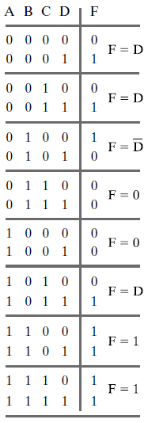
Implementing Boolean Function using MUX
F(A,B,C,D) = ∑m(1,3,4,11,12,13,14,15)
Total Variables = n = 4
Selection Variables = n-1 = 3
2^3 = 8 → 8x1 MUX Required

Slide 46
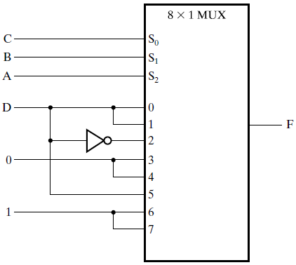
Implementing Boolean Function using MUX
F(A,B,C,D) = ∑m(1,3,4,11,12,13,14,15)
MUX Implementation of four variable function

Slide 47
Implementing Boolean Function using MUX
F(A,B,C,D) = ∑m(1,3,4,11,12,13,14,15)
Can you implement this function using 4x1 MUX having A and B as Selection Inputs and
C and D as Data Inputs?

Slide 48
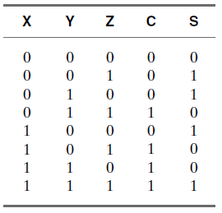
Multiplexer Implementation of 1 Bit Adder
2 Output bits → Dual MUX Required
Total input variables = n = 3
Selection inputs = n-1 = 2
Required MUX Size:
(2^2) 4 x 1 Dual MUX

Slide 49
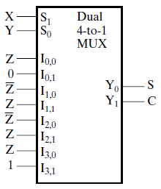
Multiplexer Implementation of 1 Bit Adder
Ix,y means Information no. x and bit y

Slide 50
Multiplexer Implementation of 1 Bit Adder
00
Ix,y means Information no. x and bit y

Slide 51
Multiplexer Implementation of 1 Bit Adder
01
Ix,y means Information no. x and bit y

Slide 52
Multiplexer Implementation of 1 Bit Adder
10
Ix,y means Information no. x and bit y

Slide 53
Multiplexer Implementation of 1 Bit Adder
11
Ix,y means Information no. x and bit y

Slide 54


Implementing Function using MUX
Determine Function Implemented by following MUX
A | B | C | D | F
0 | 0 | 0 | 0
0 | 0 | 0 | 1
0 | 0 | 1 | 0
0 | 0 | 1 | 1
0 | 1 | 0 | 0
0 | 1 | 0 | 1
0 | 1 | 1 | 0
0 | 1 | 1 | 1
1 | 0 | 0 | 0
1 | 0 | 0 | 1
1 | 0 | 1 | 0
1 | 0 | 1 | 1
1 | 1 | 0 | 0
1 | 1 | 0 | 1
1 | 1 | 1 | 0
1 | 1 | 1 | 1
1
I0
C
I1
D
4×1
MUX
F(A,B,C,D)
C
I2
D
D
I3
S1
S0
A
B

Slide 55
Implementing Function using MUX
Determine Function Implemented by following MUX
A | B | C | D | F
0 | 0 | 0 | 0 | 1
0 | 0 | 0 | 1 | 1
0 | 0 | 1 | 0 | 1
0 | 0 | 1 | 1 | 1
0 | 1 | 0 | 0 | 0
0 | 1 | 0 | 1 | 0
0 | 1 | 1 | 0 | 0
0 | 1 | 1 | 1 | 1
1 | 0 | 0 | 0 | 1
1 | 0 | 0 | 1 | 0
1 | 0 | 1 | 0 | 0
1 | 0 | 1 | 1 | 0
1 | 1 | 0 | 0 | 0
1 | 1 | 0 | 1 | 1
1 | 1 | 1 | 0 | 0
1 | 1 | 1 | 1 | 1
1
I0
C
I1
D
4×1
MUX
F(A,B,C,D)
C
I2
D
D
I3
S1
S0
A
B

Slide 56
DeMultiplexer

Slide 57
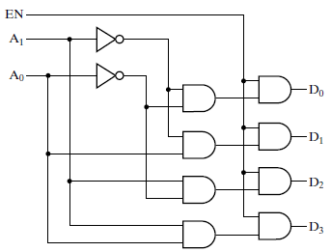
Demultiplexer
Data Input
1-to-4 Line Demultiplexer
Inverse of Multiplexer
Receives information from single line
Transmits it to one of 2^n output lines
Based on n Selection Inputs
Circuit is same as 2x4 Line Decoder with enable input

Slide 58
Demultiplexer
Data Input
0
0
1
0
1
0
For example,
(S1S0) = (10)2
1-to-4 Line Demultiplexer

Slide 59
Demultiplexer
Data Input
0
0
1
0
0
0
1
Data Input
0
0
For example,
(S1S0) = (10)2
1-to-4 Line Demultiplexer

Slide 60
1-to-m Line Demultiplexer
Data Input
S0
D0
D1
S1
1×2^{n}
Demultiplexer
(m = 2^{n})
D2
.
.
.
.
.
.
Sn-1
Dm-2
Dm-1

Slide 61
Making Larger Size MUX using Smaller MUX(s)

Slide 62
Dual 2x1 MUX Using single 2x1 MUX(s) Only
A0
2x1
MUX
Selection Input S | Y
0 | A
1 | B
B0
Y0
S
A1
2x1
MUX
B1
Y1
S

Slide 63
Dual 2x1 MUX Using single 2x1 MUX(s) Only
A0
2x1
MUX
Selection Input S | Y
0 | A
1 | B
B0
Y0
1
S
A1
2x1
MUX
B1
Y1
S
1

Slide 64
Dual 2x1 MUX Using single 2x1 MUX(s) Only
A0
2x1
MUX
Selection Input S | Y
0 | A
1 | B
B0
Y0
= B0
1
S
A1
2x1
MUX
B1
Y1
= B1
S
1

Slide 65
Dual 2x1 MUX Using single 2x1 MUX(s) Only
A0
2x1
MUX
Selection Input S | Y
0 | A
1 | B
B0
Y0
= A0
0
S
A1
2x1
MUX
B1
Y1
= A1
S
0

Slide 66
Implement 17x1 MUX using 4x1 MUX(s) and 2x1 MUX(s)
17x1
MUX
I16-I0
Y
S4
S3
S2
S1
S0

Slide 67
Implement 17x1 MUX using 4x1 MUX(s) and 2x1 MUX(s) Condensed Truth Table
Selection Input | Output | Selection Input | Output
S4S3S2S1S0 | Y | S4S3S2S1S0 | Y
00000 | I0 | 01000 | I8
00001 | I1 | 01001 | I9
00010 | I2 | 01010 | I10
00011 | I3 | 01011 | I11
00100 | I4 | 01100 | I12
00101 | I5 | 01101 | I13
00110 | I6 | 01110 | I14
00111 | I7 | 01111 | I15
 |  | 10000 | I16
 |  | Rest of Combinations | Don’t Care

Slide 68
17x1 MUX using 4x1 and 2x1 MUX(s)
4x1
MUX
I3-I0
S1
S0
4x1
MUX
I0
4x1
MUX
I7-I4
I1
2x1
MUX
S1
S0
Y
4x1
MUX
I16
I11-I8
I2
S1
S0
S4
I3
4x1
MUX
I15-I12
S3
S2
S1
S0

Slide 69
17x1 MUX using 4x1 and 2x1 MUX(s)
4x1
MUX
I3-I0
Selection Input = 01100
Expected Result:
Y = I12
S1
S0
4x1
MUX
I0
4x1
MUX
I7-I4
I1
2x1
MUX
S1
S0
Y
4x1
MUX
I16
I11-I8
I2
S1
S0
S4
I3
4x1
MUX
I15-I12
S3
S2
S1
S0

Slide 70
17x1 MUX using 4x1 and 2x1 MUX(s)
4x1
MUX
I3-I0
Selection Input = 01100
Expected Result:
Y = I12
0
0
S1
S0
4x1
MUX
I0
4x1
MUX
I7-I4
I1
2x1
MUX
0
0
S1
S0
Y
4x1
MUX
I16
I11-I8
I2
0
0
S4
S1
S0
I3
4x1
MUX
I15-I12
S3
S2
0
0
S1
S0

Slide 71
17x1 MUX using 4x1 and 2x1 MUX(s)
4x1
MUX
I0
I3-I0
Selection Input = 01100
Expected Result:
Y = I12
0
0
S1
S0
4x1
MUX
I0
4x1
MUX
I4
I7-I4
I1
2x1
MUX
0
0
S1
S0
Y
4x1
MUX
I8
I16
I11-I8
I2
0
0
S4
S1
S0
I3
4x1
MUX
I12
I15-I12
S3
S2
0
0
S1
S0

Slide 72
17x1 MUX using 4x1 and 2x1 MUX(s)
4x1
MUX
I0
I3-I0
Selection Input = 01100
Expected Result:
Y = I12
0
0
S1
S0
4x1
MUX
I0
4x1
MUX
I4
I7-I4
I1
I12
2x1
MUX
0
0
S1
S0
Y
4x1
MUX
I8
I16
I11-I8
I2
0
0
S4
S1
S0
I3
4x1
MUX
I12
I15-I12
1
1
S3
S2
0
0
S1
S0

Slide 73
17x1 MUX using 4x1 and 2x1 MUX(s)
4x1
MUX
I0
I3-I0
Selection Input = 01100
Expected Result:
Y = I12
0
0
S1
S0
4x1
MUX
I0
4x1
MUX
I4
I7-I4
I1
I12
2x1
MUX
0
0
I12
S1
S0
Y
4x1
MUX
I8
I16
I11-I8
I2
0
0
0
S4
S1
S0
I3
4x1
MUX
I12
I15-I12
1
1
S3
S2
0
0
S1
S0

Slide 74
17x1 MUX using 4x1 and 2x1 MUX(s)
4x1
MUX
I3-I0
Selection Input = 10000
Expected Result:
Y = I16
S1
S0
4x1
MUX
I0
4x1
MUX
I7-I4
I1
2x1
MUX
S1
S0
Y
4x1
MUX
I16
I11-I8
I2
S1
S0
S4
I3
4x1
MUX
I15-I12
S3
S2
S1
S0

Slide 75
17x1 MUX using 4x1 and 2x1 MUX(s)
4x1
MUX
I3-I0
Selection Input = 10000
Expected Result:
Y = I16
0
0
S1
S0
4x1
MUX
I0
4x1
MUX
I7-I4
I1
2x1
MUX
0
0
S1
S0
Y
4x1
MUX
I16
I11-I8
I2
0
0
S4
S1
S0
I3
4x1
MUX
I15-I12
S3
S2
0
0
S1
S0

Slide 76
17x1 MUX using 4x1 and 2x1 MUX(s)
4x1
MUX
I0
I3-I0
Selection Input = 10000
Expected Result:
Y = I16
0
0
S1
S0
4x1
MUX
I0
4x1
MUX
I4
I7-I4
I1
2x1
MUX
0
0
S1
S0
Y
4x1
MUX
I8
I16
I11-I8
I2
0
0
S4
S1
S0
I3
4x1
MUX
I12
I15-I12
S3
S2
0
0
S1
S0

Slide 77
17x1 MUX using 4x1 and 2x1 MUX(s)
4x1
MUX
I0
I3-I0
Selection Input = 10000
Expected Result:
Y = I16
0
0
S1
S0
4x1
MUX
I0
4x1
MUX
I4
I7-I4
I1
I0
2x1
MUX
0
0
S1
S0
Y
4x1
MUX
I8
I16
I11-I8
I2
0
0
S4
S1
S0
I3
4x1
MUX
I12
I15-I12
0
0
S3
S2
0
0
S1
S0

Slide 78
17x1 MUX using 4x1 and 2x1 MUX(s)
4x1
MUX
I0
I3-I0
Selection Input = 01100
Expected Result:
Y = I12
0
0
S1
S0
4x1
MUX
I0
4x1
MUX
I4
I7-I4
I1
I0
2x1
MUX
0
0
I16
S1
S0
Y
4x1
MUX
I8
I16
I11-I8
I2
1
0
0
S4
S1
S0
I3
4x1
MUX
I12
I15-I12
1
1
S3
S2
0
0
S1
S0

